Slide 1

Georgia Gap Analysis
Strategic Planning and Analysis Division
Program Office
E&E Bureau
USAID
February 23, 2018 DRAFT

Slide 2
Reforms and governance

Slide 3
Economic and Democratic Reforms in Eastern Europe and Eurasia in 2017
Figure 1
Advanced
Comparators
Estonia
Slovakia
Slovenia
Hungary
Lithuania
Latvia
Poland
Croatia
Romania
Russia
Georgia
Montenegro
Bulgaria
Armenia
Serbia
Belarus
Ukraine
Macedonia
Kazakhstan
Moldova
Albania
E&E Graduates
The Balkans
E&E Eurasia
CARs
Azerbaijan
B-H
Tajikistan
Kyrgyz R.
Kosovo
Uzbekistan
Turkmenistan
USAID/E&E Monitoring Country Progress (MCP) team. Ratings are based on a 1 to 5 scale, with 5 representing most advanced. Data derived from Freedom House, Nations in Transit (April 2017); Freedom House, Freedom in the World (January 2018),and the European Bank for Reconstruction and Development (EBRD), Transition Report (November 2017). Advanced comparator countries include Germany, Sweden, and the United States.

Slide 4
Economic and Democratic Reforms in Eastern Europe and Eurasia in 2017
Figure 2
Advanced
Comparators
Estonia
Slovakia
Slovenia
Hungary
Latvia
Poland
Lithuania
Croatia
Romania
Bulgaria
Russia
Armenia
Georgia
Mont
E&E grads
Belarus
Ukraine
Mac.
Serbia
Kazakhstan
Moldova
Albania
Azerbaijan
B-H
Tajikistan
Kyrgyz R.
Kosovo
Uzbekistan
Turkmenistan
USAID/E&E Monitoring Country Progress (MCP) team. Ratings are based on a 1 to 5 scale, with 5 representing most advanced. Data derived from Freedom House, Nations in Transit (April 2017); Freedom House, Freedom in the World (January 2018),and the European Bank for Reconstruction and Development (EBRD), Transition Report (November 2017). Advanced comparator countries include Germany, Sweden, and the United States.

Slide 5
E&E Graduates: Then and Now (Year of Graduation vs. 2016)
Figure 3
Hungary
(1999)
Poland
(2000)
Croatia
(2006)
Bulgaria
(2006)
Romania
(2006)
Slovakia
(2000)
Slovenia
(1997)
Lithuania
(2000)
Estonia
(1996)
Latvia
(1999)
E&E, Monitoring Country Progress (MCP) system, drawing from EBRD, Transition Reports and Freedom House, Nations in Transit . Insufficient econ. data for Czech R. (1997 graduate).

Slide 6
Figure 4
2017 trends
(arrows)
USAID MCP team. Data derived from Freedom House, Nations in Transit series (2017 and earlier editions). The E&E Graduates (n=11) consist of Estonia, Hungary, Latvia, Lithuania, Poland, Slovakia, Slovenia, Czech Republic, Romania, Bulgaria, and Croatia. The Balkans (n=6): Albania, Bosnia & Herzegovina, Macedonia, Kosovo, Serbia, and Montenegro. E&E Eurasia (n=7): Armenia, Azerbaijan, Belarus, Georgia, Moldova, Russia, and Ukraine. The Central Asian Republics or the CARs (n=5): Kazakhstan, Kyrgyzstan, Tajikistan, Turkmenistan, and Uzbekistan.

Slide 7
Figure 5
2017 trends
(arrows)
USAID Monitoring Country Progress (MCP) team. Data derived from Freedom House, Nations in Transit series (2017 and earlier editions). 2017 trends from 2018 Freedom in the World: Ukraine and Belarus, +1 point; Moldova, -1 point; Azerbaijan, -2 points; Georgia, Armenia, and Russia , no change in 2017.

Slide 8
Figure 6
2017 trends
(arrows)
USAID MCP system. Drawn from the EBRD Transition Report series (2016 and earlier editions). The E&E Graduates (n=11) consist of Estonia, Hungary, Latvia, Lithuania, Poland, Slovakia, Slovenia, Czech Republic, Romania, Bulgaria, and Croatia. The Balkans (n=6): Albania, Bosnia & Herzegovina, Macedonia, Kosovo, Serbia, and Montenegro. E&E Eurasia (n=7): Armenia, Azerbaijan, Belarus, Georgia, Moldova, Russia, and Ukraine. The Central Asian Republics or the CARs (n=5): Kazakhstan, Kyrgyzstan, Tajikistan, Turkmenistan, and Uzbekistan.

Slide 9
Figure 7
2017 trends
(arrows)
USAID MCP system. Drawn from the EBRD Transition Report series (2017 and earlier editions). 1989-2016 economic reforms (n=9): small-scale privatization, price liberalization, trade liberalization, large-scale privatization, enterprise governance, competition policy, bank reforms, non-bank financial reforms, energy/infrastructure reforms; 2017 reforms (n=6): competitive, well-governed, green, inclusive, resilient, and integrated. 2017: Georgia, Moldova, Azerbaijan, Belarus advanced; others no measurable change.

Slide 10
Democratic reforms in Georgia, E&E Eurasia, and the E&E Graduates in 2016
Figure 8
Electoral process (3.50)
Anti-corruption (3.50)
Civil society (4.25)
E&E Graduates
Georgia
E&E Eurasia
Rule of law (3.25)
Independent media (4.0)
Local democratic governance (2.75)
National democratic governance (2.50)
Drawn from Freedom House, Nations in Transit (May 2017). “7” is most advanced.

Slide 11
Democratic reforms in Georgia and the E&E Graduates in 2016
Figure 9
Electoral process (3.50)
Anti-corruption (3.50)
Civil society (4.25)
Georgia
E&E Graduates
Rule of law (3.25)
Independent media (4.0)
Local democratic
governance (2.75)
National democratic
governance (2.50)
Drawn from Freedom House, Nations in Transit (May 2017). “7” is most advanced.

Slide 12
Figure 10
World Bank, World Governance Indicators (2015, online).

Slide 13
Figure 11
World Bank, World Governance Indicators (2015, online).

Slide 14
Figure 12
E&E Eurasia & CARs
Central & Eastern Europe
World Bank, Worldwide Governance Indicators and Doing Business. Correlation coefficient = 0.83. The lower the rank, the better the business environment and lower the corruption. Ten aspects go into scoring and ranking the business environment: starting a business, dealing with construction permits, getting electricity, registering property, getting credit, protecting minority investors, paying taxes, enforcing contracts, trading across borders, and resolving insolvency.

Slide 15
Fig 13 Democracy disaggreg in Georgia (like next Chart done for Ukraine)

Slide 16
Figure
Euromaidan Revolution
(Feb. 2014)
Orange Revolution
(Nov. 2004)
Global Financial Crisis
(Oct. 2008)
Yanukovych Enters Office
(Feb. 2010)
Freedom House, Nations in Transit (2017 and earlier editions). Ukraine advanced in 2016 in three dimensions of democratic reforms (national and local democratic governance and anti-corruption) and regressed in one dimension (civil society).

Slide 17
Structural economic reforms in Georgia vs. E&E Graduates in 2017
Figure 14
Competitive (2.3)
Integrated (3.3)
Well-governed (3.0)
Georgia
E&E Graduates
Resilient (2.9)
Green (2.3)
Inclusive (2.6)
EBRD, Transition Report (November 2017). E&E graduates (n=10) include Bulgaria, Croatia, Estonia, Hungary, Latvia, Lithuania, Poland, Romania, Slovakia, and Slovenia (and exclude the Czech Republic).

Slide 18
Figure 15
World Bank, World Governance Indicators (2016, online).

Slide 19
Structural economic reforms in Georgia vs. Advanced Comparator Countries in 2017
Figure 16
Competitive (2.3)
Integrated (3.3)
Well-governed (3.0)
Georgia
Advanced
Comparators
Resilient (2.9)
Green (2.3)
Inclusive (2.6)
EBRD, Transition Report (November 2017). The advanced comparator countries include Germany, Sweden, and the U.S.

Slide 20
Growth, inclusiveness, and competitiveness
Including youth population decline
Remittances
Unemployment rates over time
agriculture

Slide 21
Figure 17
Global Financial Crisis
(1999 = 100)
IMF, World Economic Outlook (October 2017).

Slide 22
Inclusive growth: declining inequality in an expanding economy
Figure 18
Poorest 40%
of population
Total population
World Bank, Shared Prosperity Database. Time periods: 2009-2014 for Macedonia, Latvia, Lithuania, Poland, and the Czech Republic; 2010-2015 for Moldova, Kazakhstan, and Russia; 2011-2016 for Georgia and Belarus; and 2012-2015 for Kosovo.

Slide 23
Economic Growth and Poverty in Georgia, 2003-2016
Figure 19
Poverty rate at $5 a day
Real GDP (annual % change)
2003
2008
2016
World Bank, Europe and Central Asia Economic Update (May 2017) and IMF, World Economic Outlook (October 2017).

Slide 24
Figure 20
Primary source: UNICEF, TransMonee Database

Slide 25
Figure 21
UNICEF, 2015 TransMonEE Database. Ages 15-24 years.

Slide 26
Figure 22
Youth Labor Force Participation Rate
among E&E Presence
U.N. Children’s Fund (UNICEF), 2016 TransMonEE Database (2017, online).

Slide 27
Labor Market Efficiency in Eastern Europe & Eurasia (Global Ranking)
Figure 23
(Global median rank = 69)
World Economic Forum, Global Competitiveness Report, 2016-2017 (2016). No data for Kosovo, Belarus, Uzbekistan, and Turkmenistan. Global sample = 138 countries. Labor market efficiency includes flexibility (including ease of hiring and firing and flexibility in wages) and efficient use of talent (pay and productivity, capacity to attract and retain talent, and female labor force participation rate). The higher the ranking, the lower the competitiveness.

Slide 28
Figure 24
OECD Avg: 490
OECD, 2015 Programme for International Student Assessment (PISA) (December 2016). The PISA scores measure the skills and knowledge of 15-year-old students in science, math, and reading in 72 countries. Science, math, and reading scores are averaged.

Slide 29
Figure 25
Estonia
Russia
Slovenia
Poland
Latvia
U.S.
Czech R.
Croatia
Lithuania
Slovakia
Romania
Bulgaria
Moldova
Albania
Montenegro
Thailand
Georgia
Colombia
Indonesia
Peru
Macedonia
Kosovo
Dominican Rep.
Georgia
Macedonia
Kosovo
OECD, 2015 Programme for International Student Assessment (PISA) (December 2016).

Slide 30
Market Size in Eastern Europe & Eurasia and Elsewhere (Global Ranking)
Figure 26
(Global median rank = 69)
World Economic Forum, Global Competitiveness Report, 2016-2017 (2016). No data for Kosovo, Belarus, Uzbekistan, and Turkmenistan. Global sample = 138 countries. Market size measures the size of the domestic economy as well as the foreign market (i.e., size of export sector). The higher the ranking, the lower the competitiveness.

Slide 31
1990-2016 population change in E&E: total population vs. youth (15-29 years)
Figure 27
Tajikistan
Uzbekistan
Turkmenistan
Kyrgyz Republic
Azerbaijan
Kazakhstan
Moldova
Armenia
Ukraine
Croatia
Slovenia
Georgia
Estonia
Lithuania
Latvia
Bosnia-Herzegovina
Calculated from PopulationPyramid.net

Slide 32
Innovation vs. Business Sophistication
Figure 28
Nepal
Bolivia
Bosnia-H
Moldova
Burundi
Zimbabwe
Georgia
Kyrgyz R.
Mozambique
Albania
Congo
Serbia
Laos
Armenia
Liberia
Montenegro
Hungary
Namibia
E&E Grads
Cote d’Ivoire
Russia
Kazakhstan
Macedonia
Ukraine
Azerbaijan
Tajikistan
Canada
India
EU-15
Switz.
U.S.
World Economic Forum, Global Competitiveness Report, 2016-2017. The EU-15 comprises Austria, Belgium, Denmark, Finland, France, Germany, Greece, Ireland, Italy, Luxembourg, Netherlands, Portugal, Spain, Sweden, and the United Kingdom. E&E graduates (n=11): Bulgaria, Croatia, Czech Rep., Estonia, Hungary, Latvia, Lithuania, Poland, Romania, Slovakia, and Slovenia. Innovation includes the capacity for innovation, the quality of scientific research institutions, spending on R&D, availability of scientists and engineers, and patent applications. Business sophistication includes the state of cluster development, value chain breadth, and extent of marketing.

Slide 33
Relations with and vulnerabilities to Russia

Slide 34
Figure 29
World Bank, World Development Indicators (2016, online). In purchasing power parity terms. 18 E&E countries; i.e., less the 11 E&E graduates.

Slide 35
Figure 30
IMF, Direction of Trade Statistics (2015). 2016 data for Armenia.

Slide 36
Figure 31
IMF, Direction of Trade Statistics (2018, online).

Slide 37
Figure 32
IMF, Direction of Trade Statistics (2018, online).

Slide 38
Figure 33
World Bank, World Development Indicators, UNCTAD FDI/TNC database, and IMF, Direction of Trade Statistics. GDP exposure to Russia’s economy through remittances, trade, and FDI.

Slide 39
Figure 34
World Bank, World Development Indicators (2015).

Slide 40
Energy Importers in E&E vs. EU-15 and the U.S. (Net Energy Imports % of Energy Use in 2013)
Figure 35
(N = 12)
World Bank, World Development Indicators (2017).

Slide 41
Russian Gas Imports as % Primary Energy Consumption in E&E and Western Europe in 2015
Figure 36
Cory Welt, Russia: Background and U.S. Interest, Congressional Research Service (March 2017), drawing from Cedigaz, industry data provider (2015); British Petroleum (BP), Statistical Review of World Energy 2016 (2016), and U.S. Energy Information Administration, International Energy Outlook (2016).

Slide 42
The Development of Georgia’s Media Sector
Figure 37
In 2017 vs. sustainability benchmark
In 2017 vs. 2012
Free speech (2.8)
Free speech
2017
Sustainable
2012
2017
Supporting
Institutions
(2.5)
Professional
Journalism
(2.4)
Supporting
Institutions
Professional
Journalism
Business
Management (1.6)
Plurality
of news (2.5)
Business
Management
Plurality
of news
Gaps against benchmarks = 3.2
Broad-based gains
(from upper end “unsustainable mixed” in 2012
to lower end “near sustainability” in 2017)
IREX, Media Sustainability Index (2017).

Slide 43
Eastern Europe & Eurasian Countries advancing towards media sustainability from 2012 to 2017
Figure
Sustainability threshold
2017
2012
IREX, Media Sustainability Index (2017).

Slide 44
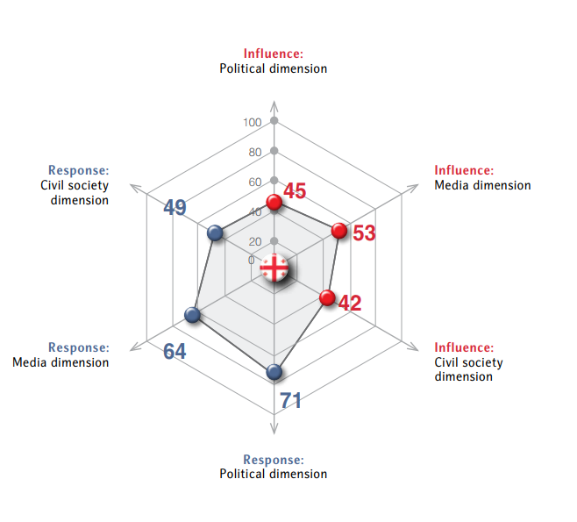
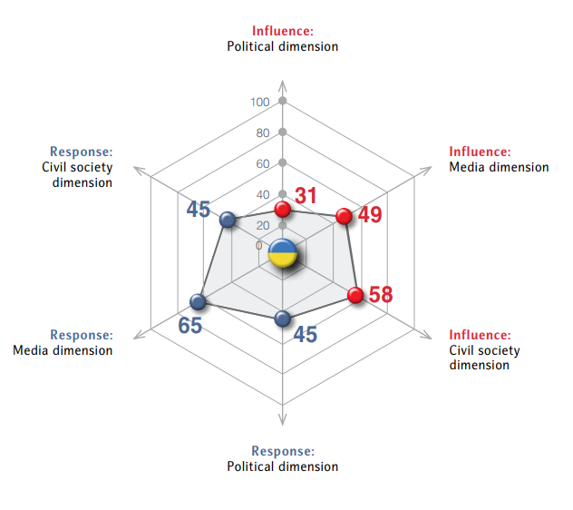
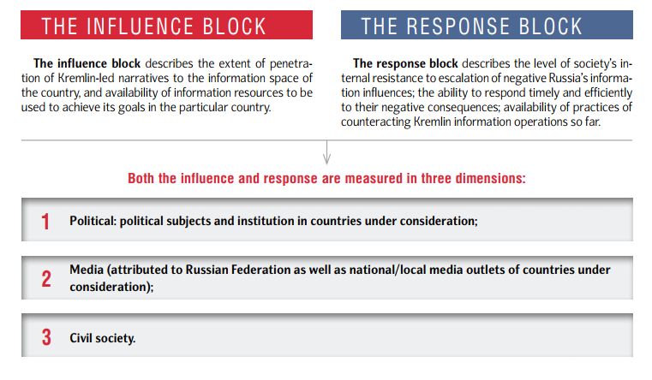
Figure 38
Kremlin Influence & Response
Georgia
Ukraine
Kremlin Influence Index 2017.

Slide 45
Democratic Reforms, Freedom House, Nations in Transit (May 2017)
Appendix Figure 1
National democratic governance: Considers democratic character and stability of governmental systems; independence, effectiveness, and accountability of legislative and executive branches;
Electoral process: Examines national executive and legislative elections, electoral process, the development of multiparty systems, and popular participation in political process;
Civil society: Assesses the growth of nongovernmental organizations (NGOs), their organizational capacity and financial sustainability and the legal and political environment in which they function; the development of free trade unions; and interest group participation in the policy process;
Independent media: Address the current state of press freedom, including libel laws, harassment of journalists, and editorial independence; the emergence of a financially viable private press; and internet access for private citizens;
Local democratic governance: Considers the decentralization of power; the responsibilities, election, and capacity of local governmental bodies; and the transparency of accountabilty of local authorities;
Judicial framework and independence: highlights constitutional reform, human rights protections, criminal code reform, judicial independence, the status of ethnic minority rights, guarantees of equality before the law, treatment of suspects and prisoners and compliance with judicial decisions;
Corruption: focuses on public perceptions of corruption, the business interests of top policymakers, laws on financial disclosure and conflict of interest, and the efficacy of anticorruption mechanisms.

Slide 46
Structural Economic Reforms (or six qualities of a sustainable market economy) according to the EBRD, Transition Report (November 2017)
Appendix Figure 2
Competitive: (1) market structures for competition and business standards (including measures of openness, business skills, and business environment); (2) capacity to add value and innovate (including measures of access to appropriate infrastructure and resources); n=15 indicators;
Well-governed: (1) national-level public governance (including control of corruption and rule of law); (2) corporate-level governance (complemented by a measure of integrity); n=22 indicators;
Green: (1) mitigation of climate change; (2) adaptation to climate change (carbon intensity, and renewables); (3) other environmental areas (including environmental outcomes such as air pollution, generation of waste, and biodiversity); n=27 indicators;
Inclusive: (1) gender equality; (2) regional disparities; (3) opportunities for youth; n=88 indicators;
Resilient: (1) financial stability (mostly health and regulation of banking sector); (2) resilient energy sector (mostly domestic and cross-border connectivity, but also legal and regulatory considerations in electricity and gas markets); n=24 indicators;
Integrated: (1) openness to foreign trade, investment and finance; (2) domestic and cross-border infrastructure (including quality of energy and ICT infrastructure); n=20 indicators.

